Slide 1
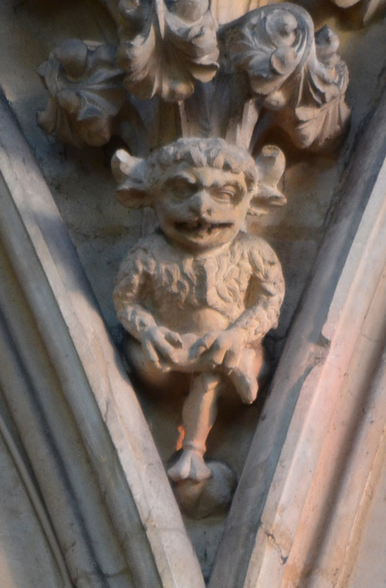
IMP77
A RETROGRADE Language and Compiler

Slide 2
OVERVIEW
History
Language Features
Compiler
Future plans
Demon-stration

Slide 3
HISTORY

Slide 4
Background HISTORY
IMP short for “IMPlementation language”
Used as a systems implementation language (similar to the use of C for operating systems)
Born 1960’s Edinburgh University
Based on Atlas Autocode
language (Algol 60 variant) used on Manchester University Atlas computer
Used to implement machine compilers and operating systems
PDP-11, VAX, ICL 2900, Perkin-Elmer
EMAS (Edinburgh Uni designed operating system)
Used by IC design company Lattice Logic (Edinburgh U spinoff) for ECAD software
Project (1982) with Ferranti Electronics to extend ECAD to design Ferranti ULA’s
Ferranti ULA (Uncommitted Logic Array) used in BBC Micro, Sinclair Spectrum etc.
I was AutoLayout Group leader + liaison with Lattice Logic

Slide 5
IMP77 Language Features

Slide 6
IMP77 Code Structure
Block based structure
Routines/Functions are named blocks
Blocks can be embedded within blocks
Block can contain one or more statements
Statements are line-based
Multi-statements lines have statements separated by semi-colon (;)
Multi-line statements must have a continuation indicator at line end (%c)
%c (or c ) is a keyword
Comments
Single line comments start with !
Text after ! Ignored till line end
Single line comments alternatively start with comment following text is ignored until line end
{} comments can occur between identifiers, keywords, operators
Text between { and } is ignored
NO newlines allowed inside { }

Slide 7
Keywords
Keywords start with %
Think of the % sign as starting to “underline” a keyword
Keywords are case insensitive (but converted to ASCII uppercase inside the compiler)
Examples
%begin, %BeGIn, %cycle, %repeat, %for, %while, %routine, %record
begin, BeGIn, cycle, repeat, for, while, routine, record
Can concatenate keywords (and in some cases abbreviate)
integer function
integerfunction
integerfn

Slide 8
IDENTIFIERS
Identifiers don’t start with a %
Consist of alpha-numeric letters with spaces allowed!
Case insensitive (again converted to uppercase inside the compiler)
Examples
freD, fRED, f r e D ! All refer to same identifier FRED
Can be difficult when searching source code
Especially if you added an extra space character (or more)
Or added spaces in a part of the identifier!!!

Slide 9
OPERATORS
Numerous operators available
Assignment: = , == , <
Add/subtract: + , -, ++, --
Multiply/divide: *, /, //, ^, ^^
Shift: <<, >>
Comparison: =, <, >, #, >=, <=, \=, <>, ~=
Logical: AND, OR, NOT
these are IMP keywords

Slide 10
IMP77 PRIMITIVE Datatypes (Numbers + Text)
Real number (32-bit + 64-bit accuracy)
real pi = 3.1415926
Integers (8-bit, 16-bit, 32-bit accuracy)
long integer bill owing = 100000 {32-bit integer}
short integer fred = 1200 {16-bit integer}
byte letter A = 65 {8-bit integer}
Strings (maximum size 255 chars)
String size should be shown in declaration, 255 assumed if omitted
string(3) TLA = “tla” {string TLA can only allow 3 characters at most}
string (2) fred = “a longer string” {generates compiler error}

Slide 11
MORE IMP PRIMITIVE Datatypes
Pointers/Addresses
Indicated by %name or name keyword
Assigned by ==
Example
integer baggins = 4 { baggins points to a memory cell containing 4}
integer name bilbo {bilbo points to an integer variable- needs an assignment)
Bilbo == baggins { bilbo points to same location as baggins }
NO boolean/logical type
Logical expressions ARE allowed for tests
Logical expressions used in tests for if, until, while statements
Yet we can define functions (predicate) which are true or false

Slide 12
IMP77 COMPOUND Datatypes
Arrays
integer array amounts owing(1:number of customers)
All array elements will have same type
Number of dimensions is compiler dependent
Only one-dimensional arrays can be initialised
Records
Used to “bundle” datatypes
record format ibj line ( byte the type, string(255) the data)
Each variable of this type has 2 elements, a byte integer and a string
record( ibj line) fred {defines a variable fred of format “ibj line” }

Slide 13
IMP “grammar”
Block = begin Statements end { a program is a block }
Statement one of
Declaration
Assignment
Conditional execution
Jump/Calculated Goto
Loop
Calling routines/functions

Slide 14
DECLARING VARIABLES IN IMP
Variable
integer fred, joe, bill { declares 3 variables each storing a 32-bit integer }
Routine/Function
integer function fred( integer parameter1, param2) { 2 parameters to fred }
Statements
result = parameter1 + 4*parameter2 { returned value }
end
External routine/function
real function fred alias “_cosine” spec ( real angle )
FRED the name inside IMP but referenced the linker or external code as _cosine
_cosine could be a routine written in C or even assembler

Slide 15
ConDitional Execution
Multi-statement
if (fred > joe) then start
{ statements }
finish else start
{ statements }
finish
Single statement (2 forms)
if (number > 10) then errorCode = 5
errorCode = 5 if (number > 10)
If not statement
errorCode = 5 unless (number <= 10)

Slide 16
JUMP/CALCULATED GOTO
Statements can be labelled (identifier followed by colon)
error: print string(“Error found”); newline(2)
Goto a label using ->
-> error
if (debt > 24) then -> error
-> error unless (debt <= 24)
Calculated goto same as switch in C
declaration
switch fred(3) { or however many you want }
Usage
-> fred(n) { assume variable n is 1,2,3 in this example}
Labelled statements
fred(1): bill = bill + 4 { get here if n = 1 }

Slide 17
LoopS
Based on %cycle … %repeat construct
FOR loop (multiple statements)
%for I = start, step, last %cycle
Statements
%repeat
FOR loop (single statement)
J = J + x(k) %for k= 1,1,50 { sums in J the values in the array x from 1 to 50}
WHILE
%while (x <1) %cycle
…
%repeat
REPEAT..UNTIL
%cycle
…
%repeat %until (temperature = 50)

Slide 18
Exiting / Skipping loops
Keyword exit can be used to jump out of a cycle .. repeat loop
cycle
{ statements }
exit if (fred > 34) { exit the loop to next statement AFTER repeat }
{ statements }
exit unless (fred < 34) { exit the loop using unless test }
repeat
Keyword continue can be used to skip to the next iteration of a cycle .. repeat loop
for i = 1,1,count cycle
{ statements }
continue if ( fred( i ) > 34) { skip to the repeat and continue for i + 1 }
{ statements }
repeat

Slide 19
Using routineS / FUNCTIONS
Routines can have parameters but do not return a result
Functions can have parameters AND must return a result
Function return value assignment
A function which returns a real/integer/string value
Assign using =
Fred = cosine ( angle )
{ this calls the routine cosine with 1 parameter and stores the result in fred }
A function which returns a name ( i.e. pointer)
Assign using ==
Inside function return result
result = 42 { how to return the value from within a function }

Slide 20
COMPILER ARCHITECTURE

Slide 21
Compiler PHASES
Consists of 3 phases
Phase 1 – reads source (.imp) and generate intermediate code (.icd) + listing file
Phase 2 – reads intermediate code and generate machine code + symbol data (.ibj)
Phase 3 – reads machine code + symbol data file to generate object code file (.obj)
Each phase is implemented as one program
Program compilation involves running the 3 programs connected by the interface files
Program compilation uses library code
Some library code written in IMP77
Core runtime library written in C (used for Windows/Linux)
Program object files must be linked by appropriate linker
Window linker in Visual Studio
Linux linker from GCC collection
CAVEAT – currently only Intel 386 code generator available!

Slide 22
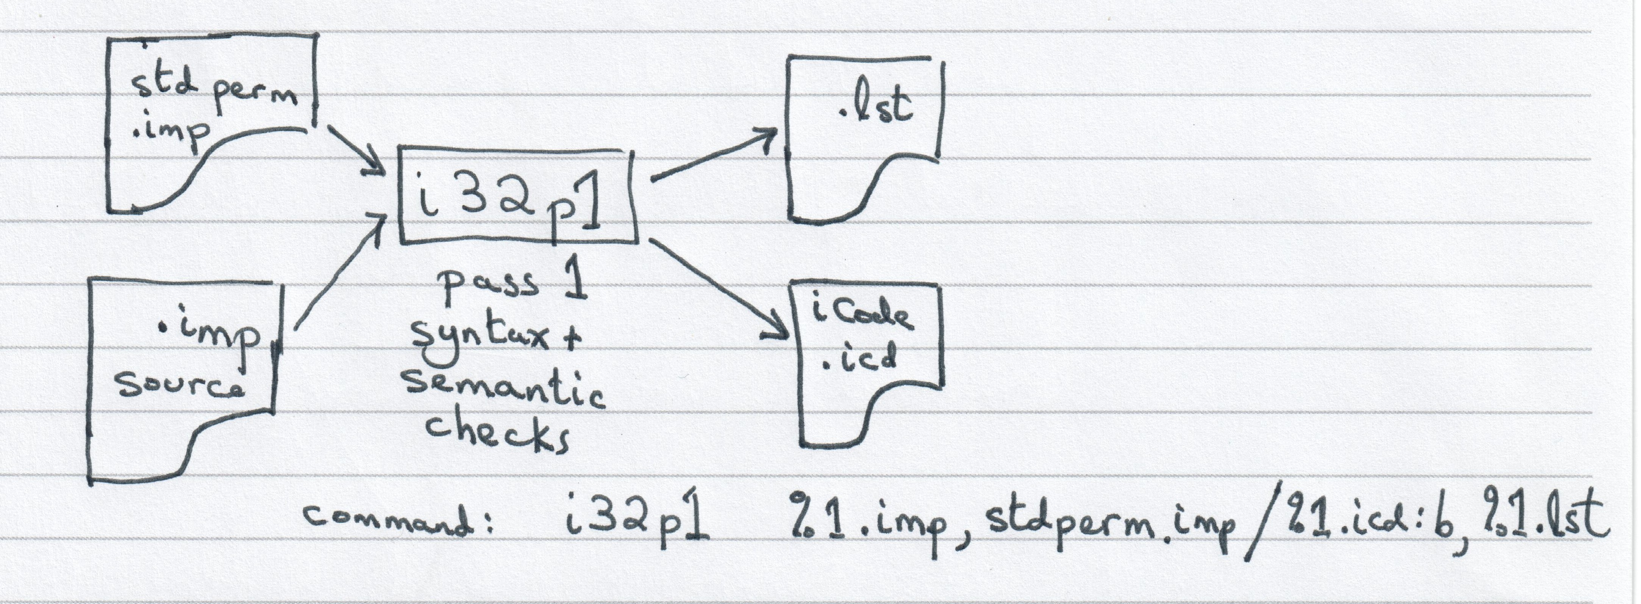
Programs and Interface Files PASS1 (Syntax Analysis)

Slide 23
PASS 1 Program
Written in IMP
Common to Windows and Linux compiler versions
Parses the IMP77 source text
Uses a table-driven parser
Parser generator (takeon) is a separate program
Generates intermediate code
Common to all machine/operating system versions of IMP77 compilers
Intermediate code could be extended for different languages (Pascal)

Slide 24
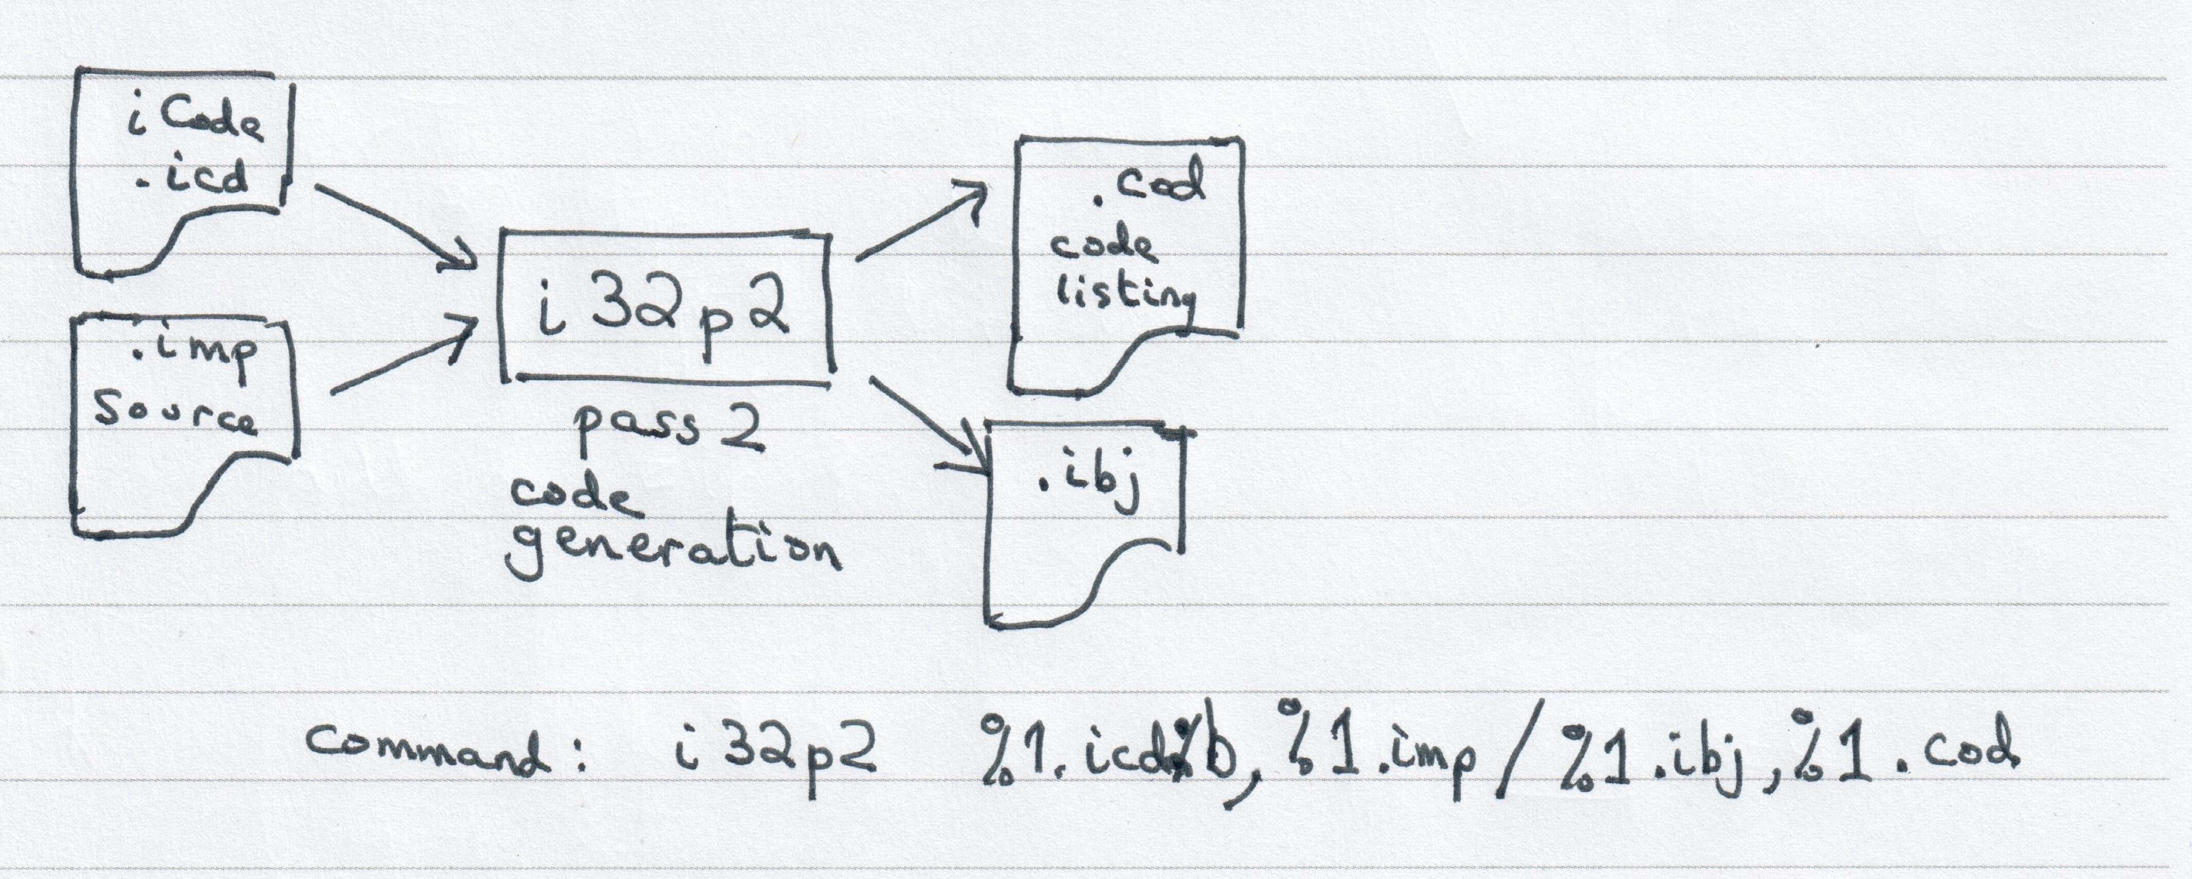
Programs and Interface Files PASS2 (Code GENERATION)

Slide 25
PASS 2 Program
Written in IMP
Source common to both Windows and Linux
Assuming an Intel 386 architecture machine
There are versions of Pass2 for other “obsolete” machines (e.g. PDP-11)
But NO compiler executables available
(except for VAX/VMS and old version of RISCOS for ARM)
Depends on format of intermediate code from Pass1

Slide 26
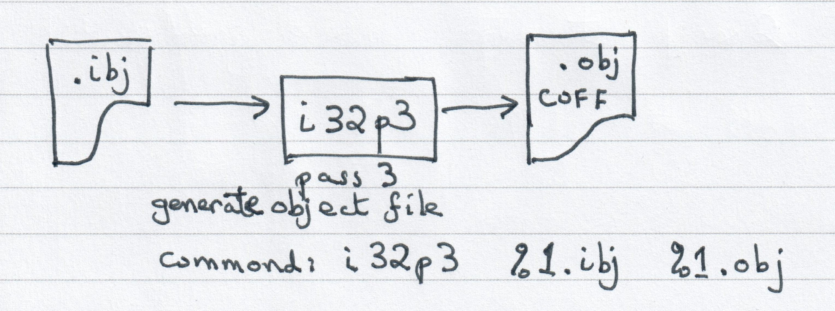
Programs and Interface Files PASS3 (COFF ObJEct File GENERATION)

Slide 27
PASS3 Program
Two versions
Windows version generates 32-bit PE/COFF object files
Linux version generates 32-bit ELF object files
Both implemented in C
But, new version of Windows PE/COFF Pass3 program
implemented in Free Pascal

Slide 28
MY COMPILER SUITE UTILITY TOOLS
icd2assembler – reads binary .icd / iCode file and generates textual version
assembler2icd – reads textual iCode and generates binary .icd /iCode file
ibj2assembler – reads pseudo binary .ibj file and generates textual version
assembler2ibj – reads textual ibj and generates pseudo-binary .ibj file
ibj2coff – reads .ibj file and generated PE/COFF file (= pass3)
ibj2compact – reads .ibj file and removes unused external symbol references
coff2dump – reads PE/COFF object and generates debug dump file
Similar to dumpbin for Windows (from Visual Studio)
All utility programs are written in Free Pascal (another “retrograde” language?)

Slide 29
Future Plans
Modify PASS2 to be able to insert machine code embedded in IMP source
PASS1 can recognise embedded machine code
Partially implemented in new PASS2 (not in .zip)
Rewrite IMP runtime library from C to IMP77
Add capability of Random Access files (read/write)
Write PASS3 PE/COFF generator in IMP77
Try to eliminate embedded instruction selection
Modify PASS2 to add jump optimisation and be the only pass for instruction selection
Write PASS3 ELF generator (for Intel 386 32-bit) in IMP77
Create new compiler suite for ARM instructions (native to Raspberry Pi)
New version of PASS2 to generate ARM instructions
Modify PASS3 ELF generator for ARM
Upgrade 32-bit compiler suite to generate 64-bit code

Slide 30
DEMON-STRATION

Slide 31
REFERENCES
Useful URLs
http://history.dcs.ed.ac.uk/archive/languages/
Useful IMP program source
http://history.dcs.ed.ac.uk/archive/staging-area/EDINBURGH_REUNION/imp77-vax/
Imp source of an IMP77 compiler for the VAX (under VAX/VMS)
https://github.com/siliconsam/imp77
Contains “working” compiler + source (from Edinburgh Uni website)
Useful documentation about IMP language and compiler implementation
Interesting URL
http://www.cs.otago.ac.nz/staffpriv/ok/anti-imp.htm

